Slide 1
Research Findings Presentation
Month 2021 | Name

Slide 2
How to use this template
Purpose: Use this template to share findings related to your research study with key stakeholders
How we use it: This is a new template! Take it for a test drive, provide feedback so we can iterate it and make it better over time.
Instructions: Make a copy and do your best to fill in as much of this as possible when synthesizing findings from your research study.
💡 Each research study is different. Adapt this as needed!

Slide 3
Background Context
Add additional context related to your study
Study Goals
Gain a deeper understanding of the current customer experience
Identify key opportunity areas for Recruit & Hub experience
Use opportunities to help inform future UXR roadmap
Key Research Questions
Add information about your key research questions

Slide 4
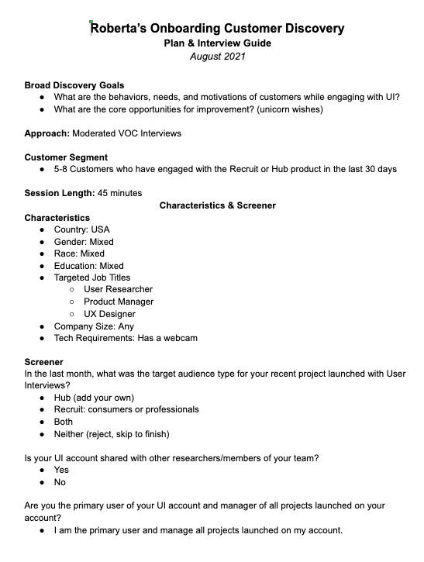
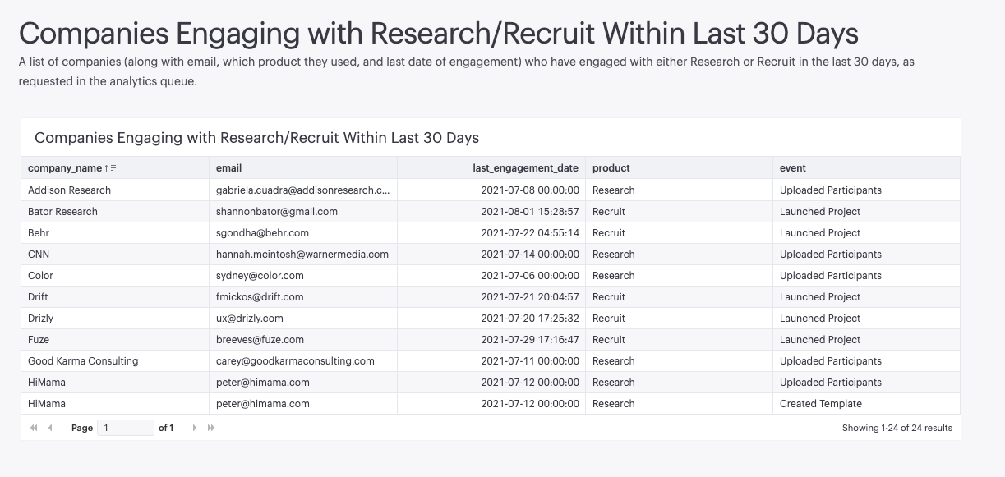
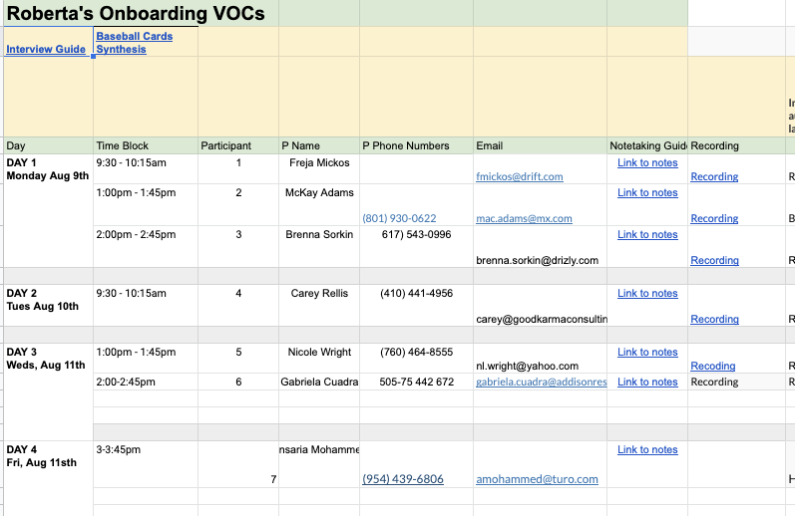
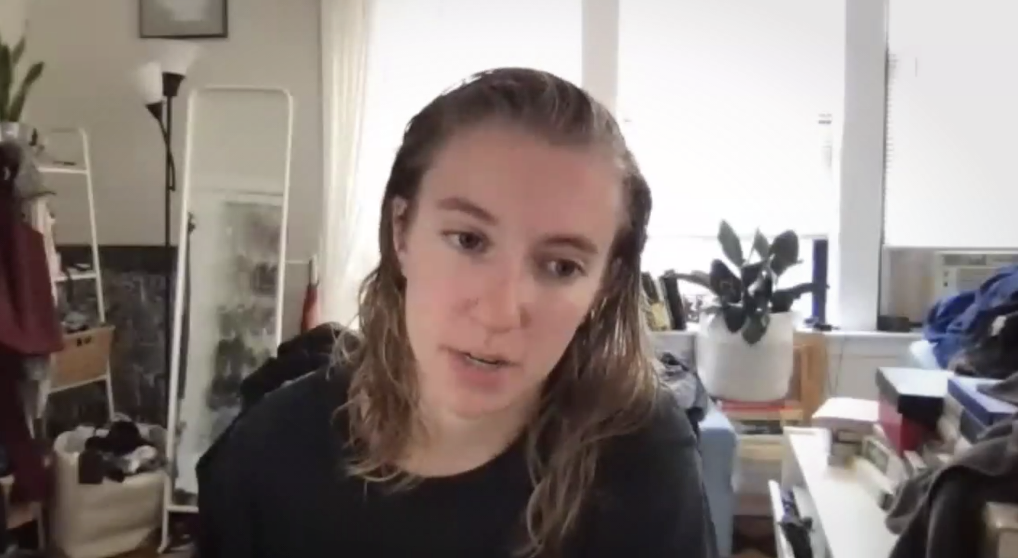
Methods & Approach
Include some photos about your approach
You can provide links to any interview guides or schedules
As well as mention how many Ps or Rs you connected with i your study

Slide 5
Overview
Our most newsworthy takeaways
WE WERE WRONG ABOUT...
Add some copy here
WE WERE RIGHT ABOUT...
Add some copy here
SURPRISES!
Add some copy here

Slide 6
Key Insights
Add a key insight theme here
You can add some supporting information here.
Why?
And any additional context about why this behavior might be showing up

Slide 7
Key Insights

Slide 8
Key Insights
Add a key insight theme here
You can add some supporting information here.
Why?
And any additional context about why this behavior might be showing up

Slide 9
Key Insights
Additional exploration or design work to consider as a result of this work
Theme Area: How might we….?
Theme Area: How might we….?
Theme Area: How might we….?
Theme Area: How might we….?
Theme Area: How might we….?
Theme Area: How might we….?

Slide 10
Key Insights
Add a key insight theme here
You can add some supporting information here.
Why?
And any additional context about why this behavior might be showing up

Slide 12
You can add an example customer quote here
“

Slide 13
Key Insights
Other notable findings
You can add additional insights related to this study that may be important here
And here

Slide 14
Key Insights
If you want to get more prescriptive around recommendations, you can add information here
High level Theme | Recommendation | Pod/ Team
Theme 1 | Add your recommendation here | Team name here
 | Add your recommendation here | Team name here
 | Add your recommendation here | Team name here
 | Add your recommendation here | Team name here
 | Add your recommendation here | Team name here
 | Add your recommendation here | Team name here
Theme 2 | Add your recommendation here | Team name here
 | Add your recommendation here | Team name here
 | Add your recommendation here | Team name here

Slide 15
Appendix & Notes

Slide 16
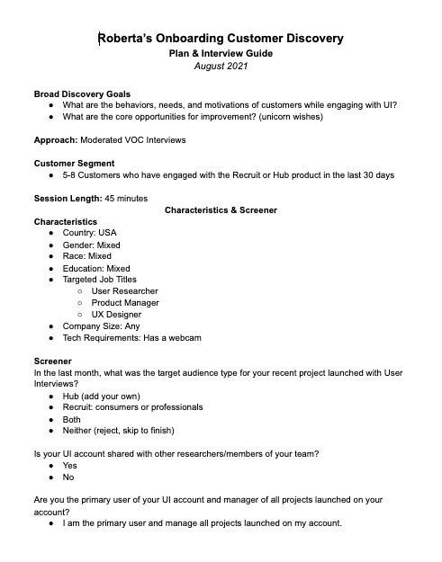
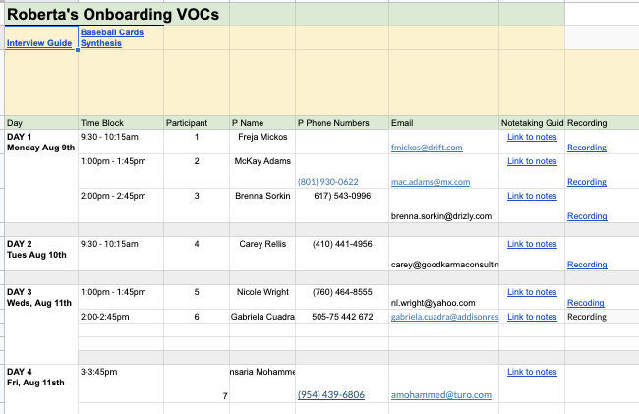
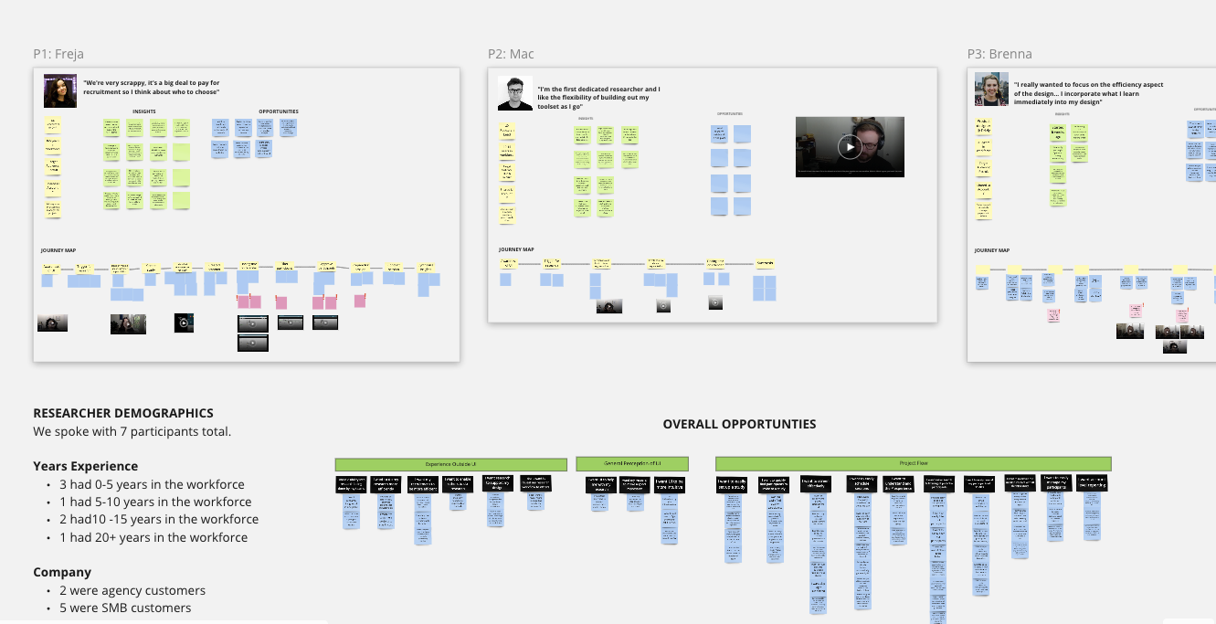
Study Resources
Add a link to your interview guide
Add a link to your interview schedule
Add a link for synthesis resources

Slide 17
Demographics information
You can add more information about P demographics here
This could include information like
Specific ICP groups
Years experience
Roles

Slide 18
Overall Theme Frequency
You can use this table to demonstrate the frequency of themes that came up during your research
High level Theme | Subtheme | Frequency
Experience outside UI | I want visibility into research being done by my teams | 2
 | I want to do my research more efficiently | 2
 | I want my recruitment to be more efficient | 3
 | I want to enable others to do research | 1
 | I want research to support my design | 2
 | I don't want to reveal my research workflow to others | 1
General Perception of UI | I want UI to help me with my research | 1
 | I want my research to make a good impression | 1
 | I want UI to be more intuitive | 3

